Slide 1
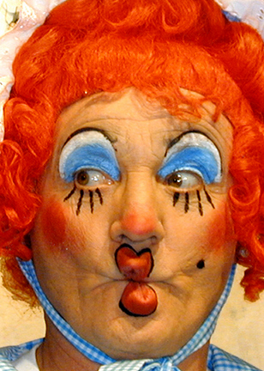
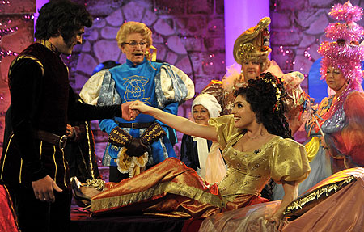
PANTOMIME
Yr 7 Drama
Lesson 1
Stock Characters

Slide 2
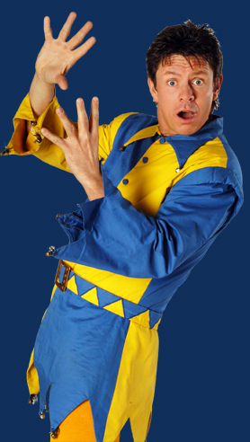
RANDOM REGISTER
In true Pantomime style let’s answer the register with an unusually large and exaggerated performance.
You can say “Yes Mam” any way that you like!

Slide 3
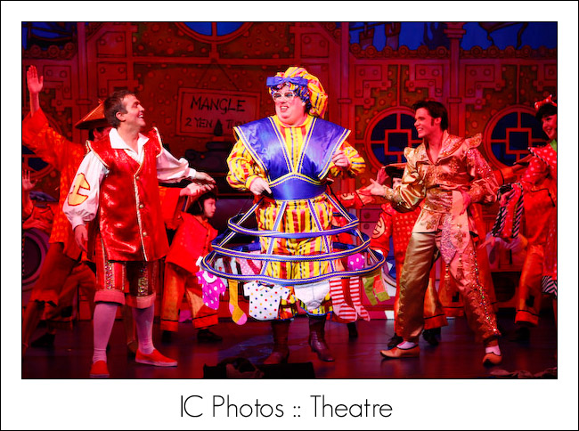
LESSON OBJECTIVE
To investigate what a ‘Stock Character’ is.

Slide 4
Level | Drama Strand
 | Creating | Performing | Reflecting
Entry | I can take part in a drama activity | I can participate in part of a group performance | I can identify positive and negative aspects within my work
1 | I can take part in a range of drama activities I can explore problems in an imagined world and make up plays from stories or other stimuli | I can participate in a short group performance I show some consideration of movement and voice in performance | I can make simple connections between the dramas I experience and my own life I can recognise when my own work and the work of others’, could be improved
2 | I can perform my own simple scenes, demonstrating an understanding of drama techniques | I can use my voice and body to create a simple character I can act out improvised dramas | I can talk about why I made certain decisions in my play I can show a basic understanding of how meaning can be shown
3 | I can establish a character with control over movement and voice I can use the dialogue in existing texts as well as creating my own I can devise plays from a range of stimuli I can respond to the use of drama techniques to deepen the role or understanding of the situation e.g. hot seating I can sustain a defined character for a reasonable amount of time | I can learn lines and organise simple performances | I can give suggestions on how work could be improved I can talk about my work using some technical drama terminology I can discuss and give reasons for my preferences in the drama I have seen

Slide 5

WALK THE WALLS
Lesson Objective:
To investigate what a ‘Stock Character’ is.
To understand how ‘stock characters’ are used within a Panto.
You have 5 minutes to walk around the room and have a look at the pictures and information on the walls.
Enjoy your stroll!
Notes:
Print off the elements of a panto power point and place each slide around the room.

Slide 6

Lesson Objective:
To investigate what a ‘Stock Character’ is.
To understand how ‘stock characters’ are used within a Panto.
Timed Pair Share
What did you find out from the walls?
You have 15 seconds “Thinking Time”
You will have 30 seconds to tell your partner when the activity starts.
The person who has the… will become partner A and speak first.
In pairs, Partner A shares as Partner B listens.
Teacher calls “time”.
Partner B thanks and praises Partner A.
Partners switch roles.

Slide 7
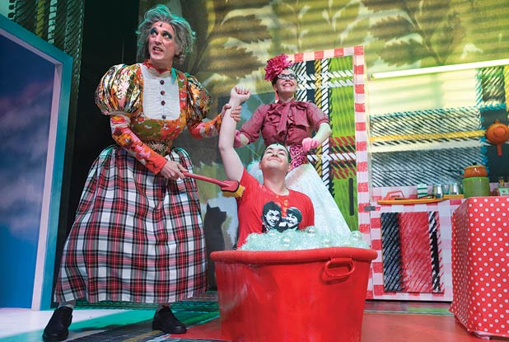
STOCK CHARACTER
Lesson Objective:
To investigate what a ‘Stock Character’ is.
To understand how ‘stock characters’ are used within a Panto.
A stock character is a fictional character that relies heavily on stereotypes for its personality, manner of speech, and other characteristics.
Stock Characters appear in all panto’s (but have different names)
Stock characters are often portrayed by wildly exaggerating the mannerisms.

Slide 8
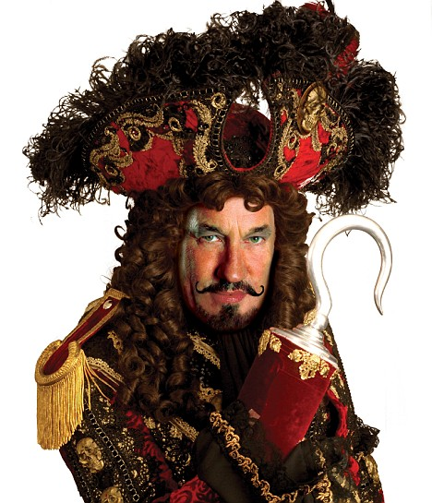
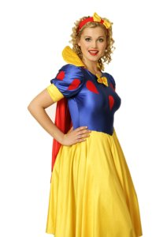
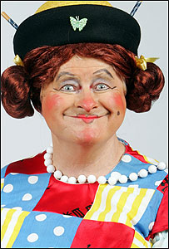
PANTOMIME STOCK CHARACTERS
Lesson Objective:
To investigate what a ‘Stock Character’ is.
To understand how ‘stock characters’ are used within a Panto.
GOODIES
BADDIES
COMIC
PRINCIPAL GIRL
DAME
UGLY SISTERS
PRINCIPAL BOY

Slide 9
WALK THE WALLS 2
Lesson Objective:
To investigate what a ‘Stock Character’ is.
To understand how ‘stock characters’ are used within a Panto.
The teacher will now walk you around the walls and tell you a little bit about all the pictures and people.
Enjoy your tour!

Slide 10
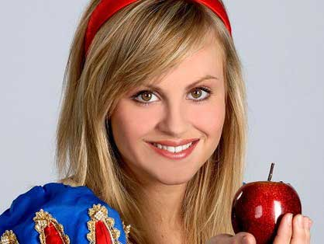
THE CHARACTER GAME
Lesson Objective:
To investigate what a ‘Stock Character’ is.
To understand how ‘stock characters’ are used within a Panto.
Each area of the room has pictures of a stock character.
When the teacher says that Stock Character you must go to the area.
The Teacher is now going to say a characters name (for example Snow White) and you must go to the Stock Character you think they are (for example Goodie or Principal Girl)

Slide 11
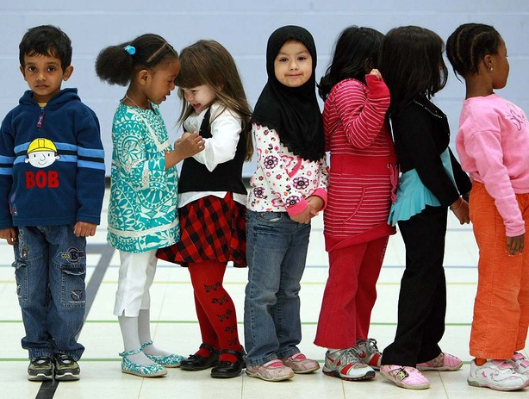
LINE UP
Lesson Objective:
To investigate what a ‘Stock Character’ is.
To understand how ‘stock characters’ are used within a Panto.
Students must form a straight line.
Students who think they have a good knowledge of pantomimes must go to one end of the line.
Students who think they have a fair knowledge of pantomimes must go to the middle of the line.
Students who think they have little knowledge of pantomimes must go to the other end of the line.

Slide 12
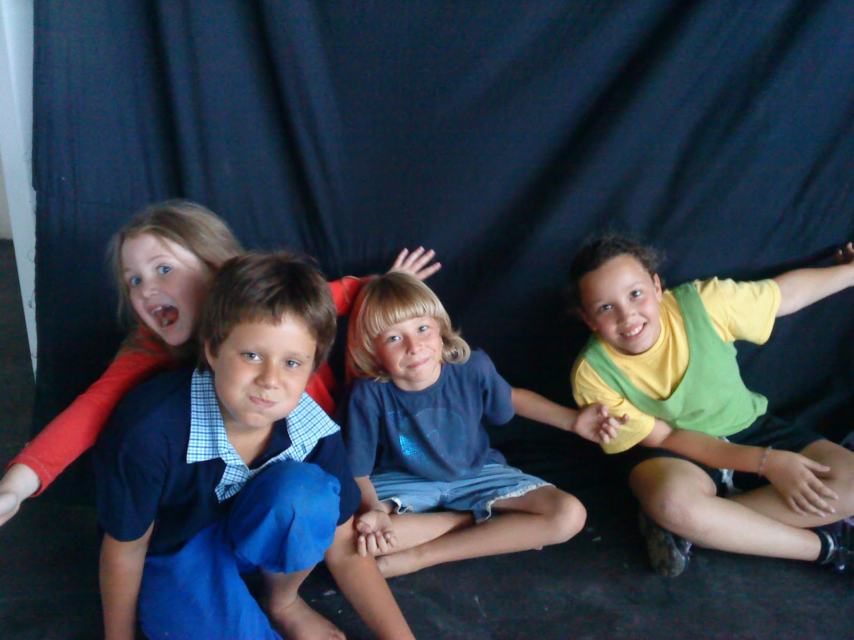
MIXED GROUPS
Lesson Objective:
To investigate what a ‘Stock Character’ is.
To understand how ‘stock characters’ are used within a Panto.
The teacher will arrange/re-arrange the groups to ensure a mix of knowledge and also a mix of boys and girls.

Slide 13
IN YOUR GROUPS THINK OF AS MANY PANTOMIME SHOWS AS YOU CAN
Lesson Objective:
To investigate what a ‘Stock Character’ is.
To understand how ‘stock characters’ are used within a Panto.
ALADDIN
SNOW WHITE & THE SEVEN DWARFS
JACK AND THE BEANSTALK
CINDERELLA
SLEEPING BEAUTY
BEAUTY AND THE BEAST

Slide 14
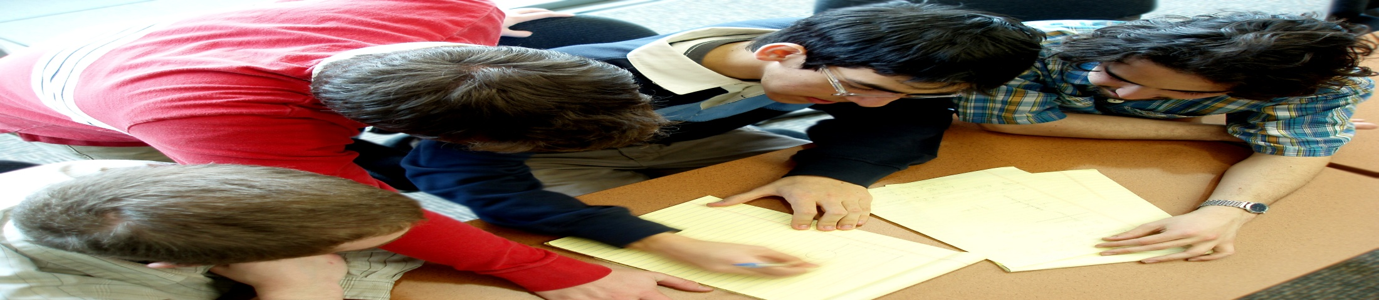
GROUP MIND-MAP
Lesson Objective:
To investigate what a ‘Stock Character’ is.
To understand how ‘stock characters’ are used within a Panto.
In your groups…
Pick a pantomime story you wish to work on
Make a list of all the characters in the show!
You have 3 minutes GO GO GO!

Slide 15
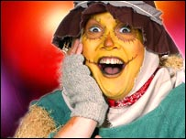
CLASS DISCUSSION
Lesson Objective:
To investigate what a ‘Stock Character’ is.
To understand how ‘stock characters’ are used within a Panto.
In your groups see if you can identify which characters from your list are STOCK CHARACTERS.
Write the type of Stock Character next the characters name on your list.

Slide 16
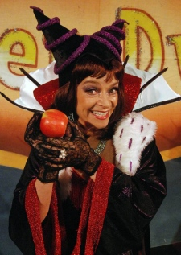
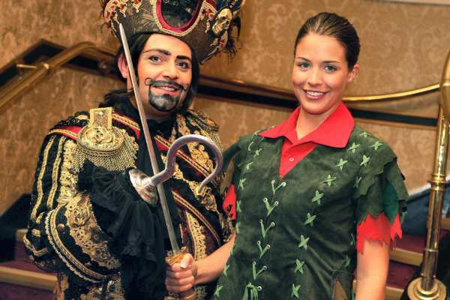
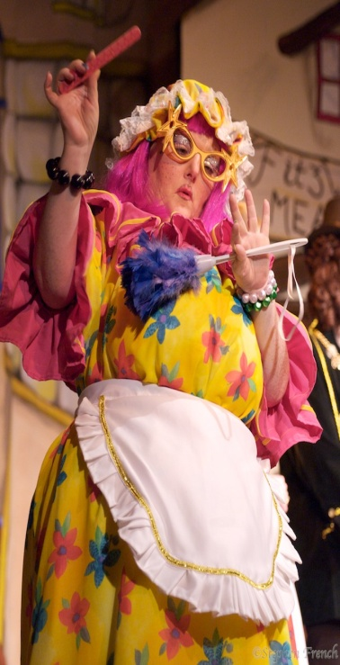
PANTOMIME STOCK CHARACTERS
Lesson Objective:
To investigate what a ‘Stock Character’ is.
To understand how ‘stock characters’ are used within a Panto.
GOODIES
BADDIES
COMIC
PRINCIPAL GIRL
DAME
UGLY SISTERS
PRINCIPAL BOY

Slide 17
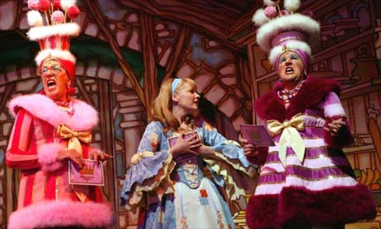
STILL IMAGE PLENARY
Lesson Objective:
To investigate what a ‘Stock Character’ is.
To understand how ‘stock characters’ are used within a Panto.
Choose a character from the pantomime you are working on.
Be ready to say…
The characters name
What type of stock character they are…eg comic, goodie etc
What pantomime show the character is from.
Working individually you must create a STILL IMAGE of the stock character you have chosen.
Remember to exaggerate the character in the image, because that is what happens in pantomime.

Slide 18
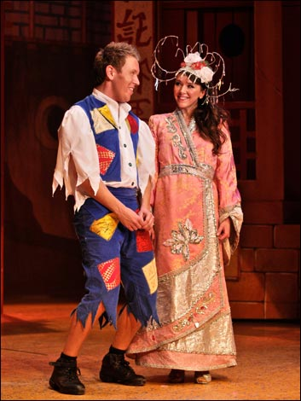
WHAT DID YOU ACHIEVE TODAY?
Summing up:
What have you learnt today?
What level have you achieve and how/ why?
What do you need to do to meet your target grade?
Get into a pair.
Share your knowledge and ideas with your partner

